Slide 1
COMBINE REPEAT FUNCTIONS INTO THE SAME FUNCTION, ALLOWING OPTIONS IN THE ARGUMENT
EDIT COLUMN INDEX TO ALLOW ONE TO PUT IN WAVENUMBERS
CONVERION CALC MODULE
SPECTRA EXTRACTION MODULE/LIBRARY
ImportCSV.py
BaselineSubtraction.py
IterativeFitting.py
AutomatedRatioExtraction.py
ConversionPlot.py
BaselineSubtractionFunction.py
FITTING PLOT TO THE RIGHT AS THE 3RD PLOT
FILE CHECKING MODULE FOR ALL APPROPRIATE FILES AT THE START
Create a step by step guide to using the library, like a README
Can combine similar functions into the same module.
REGION DEFINITION MODULE??
If no parameters found, use error handling.
HYPERPARAMETER (E.G. peak height) DEFINITION MODULE?

Slide 2
t0
T0_repeat
t30
t60
t90
t120
Df_mean
Df_std
Df_ufloat
df_conv_and_error
conversion
error

Slide 3
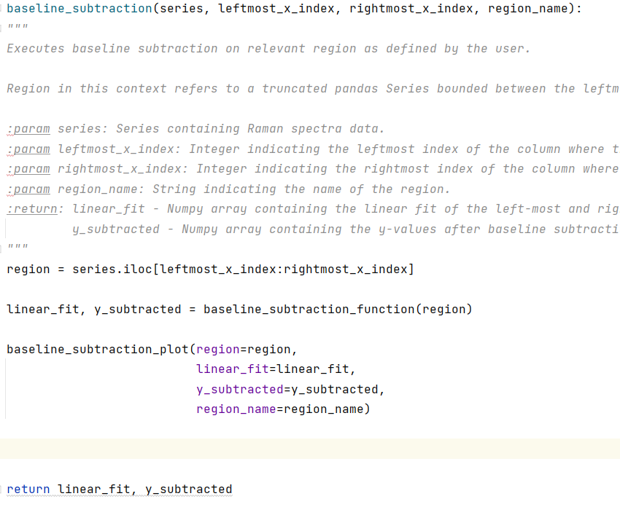
DO YOU REALLY NEED THIS HERE?

Slide 4
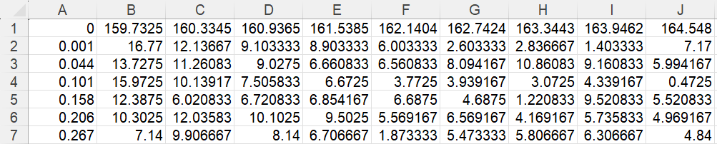
x-values
Individual spectra
in each row
y-values

Slide 5
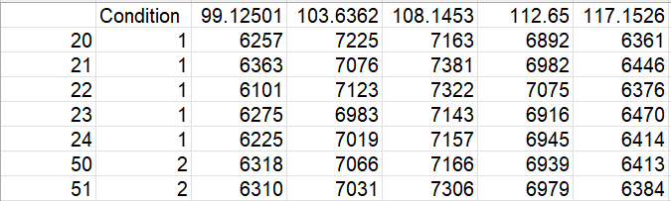
Raw Extracted Spectra .csv File
Condition
Wavenumbers
Original
Index
Intensities

